Slide 1
Communication English Department of Humanities
Netiquette
- Dr Kiran Magavi

Slide 2
Introduction
Netiquette is a combination of the words network and etiquette and is defined as a set of rules for acceptable online behavior.
Online ethics focuses on the acceptable use of online resources in an online social environment.
Online Etiquette is a set of rules that encourages appropriate and courteous online behavior.
These rules are important as they promote communication skills, prevent miscommunications, and help you understand what is socially acceptable when working and collaborating online.

Slide 3
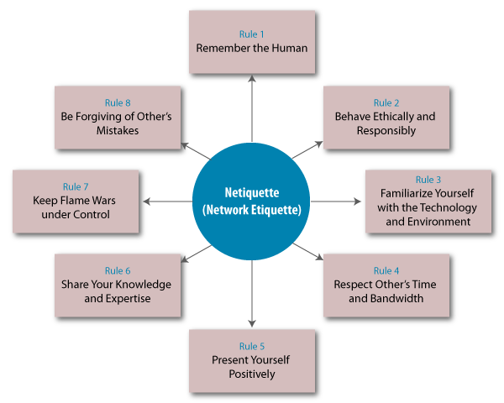
Some guidelines

Slide 4
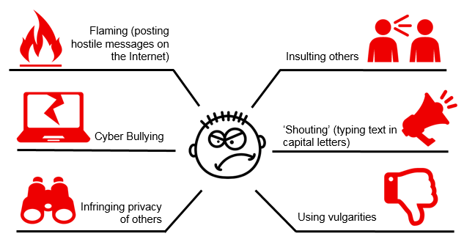
Avoid these

Slide 5
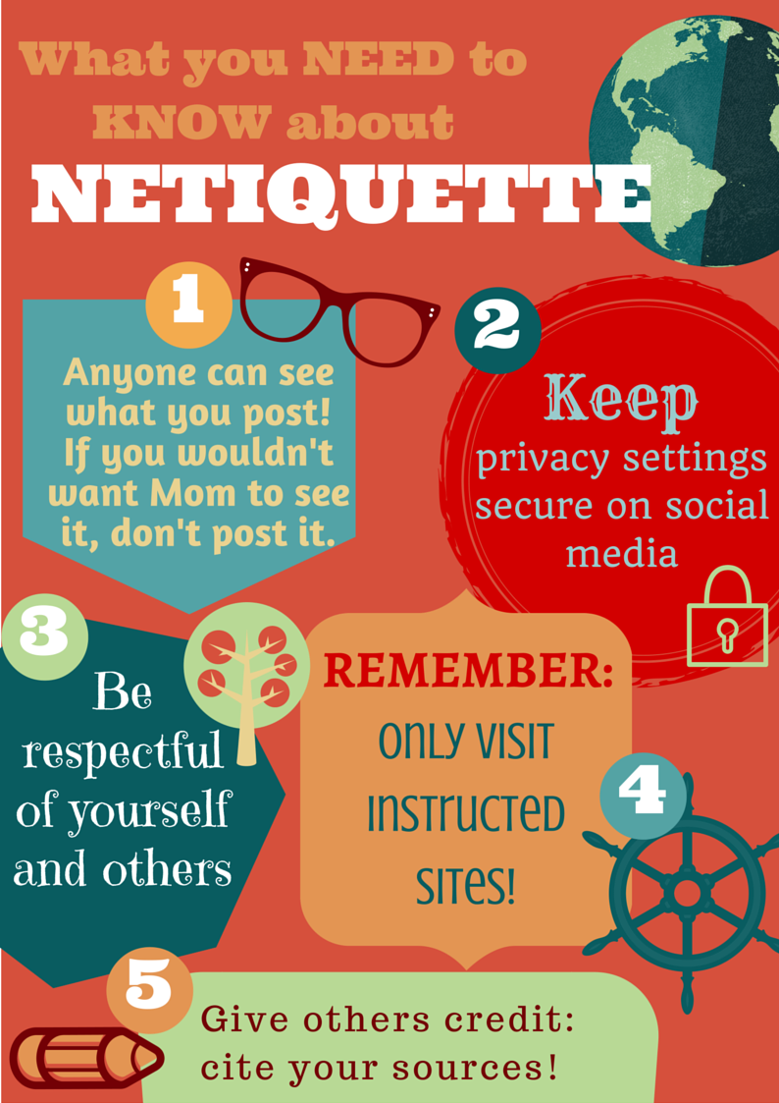
Important reminders

Slide 6
10 Basic Netiquette Rules
Make Real People a Priority
Use Respectful Language
Share With Discretion
Don't Exclude Others
Choose friends wisely
Respect people’s privacy
Fact check before reposting
Do not spam
Respond to emails and texts promptly
Update online information – esp business, job application etc

